Slide 1
The Life of Christ
Review Of The Course

Slide 2
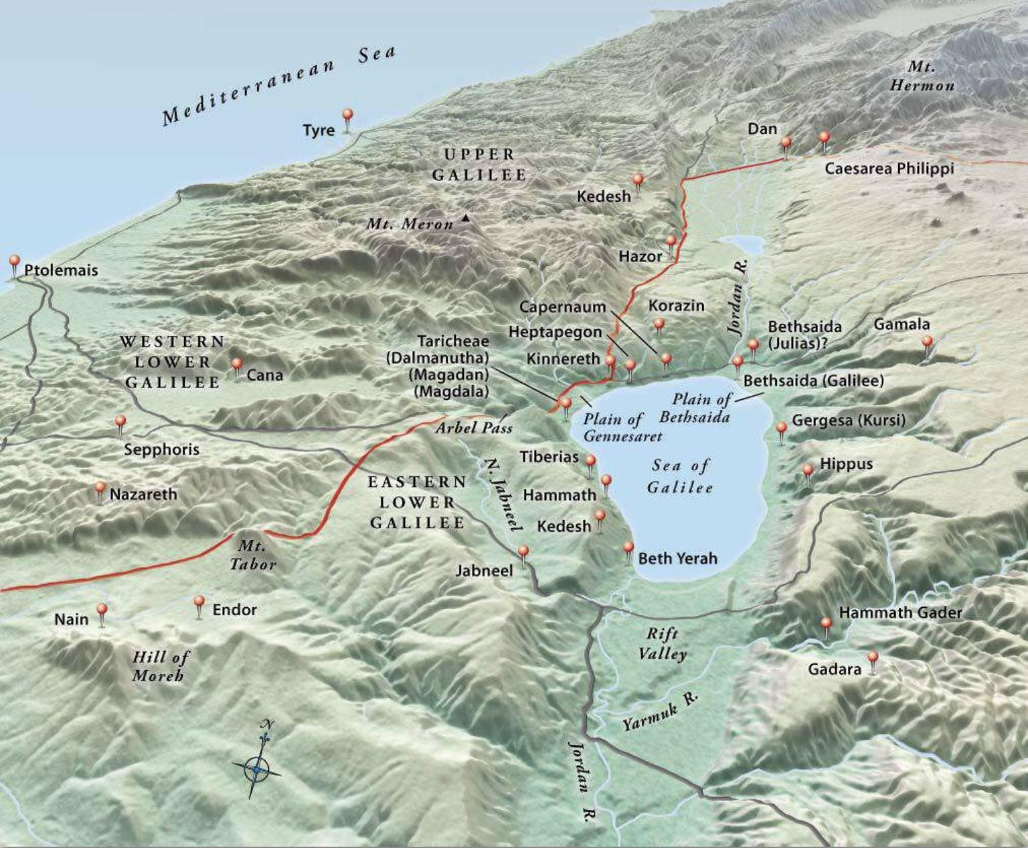
Topographical Map of Galilee (https://biblestudy.tips/bible-maps/)

Slide 3
Review: The Transfiguration
The Passion of Jesus Foretold (Matthew 16:21-28;
Mark 8:31 - 9:1; Luke 9:22-27)
The Transfiguration (Matthew 17:1-13; Mark 9:2-13;
Luke 9:28-36)
Healing the Demoniac Boy (Matthew 17:14-20; Mark 9:14-29; Luke 9:37-43)
Return to Galilee (Matthew 17:22-23; Mark 9:30-32;
Luke 9:43-45)
Jesus Pays the Tribute Money (Matthew 17:24-27)
False Ambition versus Childlikeness (Matthew 18:1-14;
Mark 9:33-50; Luke 9:46-50)
Sin and Forgiveness Between Brethren (Matthew 18:15-35)
Notes:
Matthew 16:21-28 – “21 From that time Jesus began to show his disciples that he must go to Jerusalem and suffer many things from the elders and chief priests and scribes, and be killed, and on the third day be raised. 22 And Peter took him aside and began to rebuke him, saying, ‘Far be it from you, Lord! This shall never happen to you.’ 23 But he turned and said to Peter, ‘Get behind me, Satan! You are a hindrance to me. For you are not setting your mind on the things of God, but on the things of man.’ 24 Then Jesus told his disciples, ‘If anyone would come after me, let him deny himself and take up his cross and follow me. 25 For whoever would save his life will lose it, but whoever loses his life for my sake will find it. 26 For what will it profit a man if he gains the whole world and forfeits his life? Or what shall a man give in return for his life? 27 For the Son of Man is going to come with his angels in the glory of his Father, and then he will repay each person according to what he has done. 28 Truly, I say to you, there are some standing here who will not taste death until they see the Son of Man coming in his kingdom.’“
Mark 8:31-9:1 – “31 And he began to teach them that the Son of Man must suffer many things and be rejected by the elders and the chief priests and the scribes and be killed, and after three days rise again. 32 And he said this plainly. And Peter took him aside and began to rebuke him. 33 But turning and seeing his disciples, he rebuked Peter and said, ‘Get behind me, Satan! For you are not setting your mind on the things of God, but on the things of man.’ 34 And he called to him the crowd with his disciples and said to them, ‘If anyone would come after me, let him deny himself and take up his cross and follow me. 35 For whoever would save his life will lose it, but whoever loses his life for my sake and the gospel's will save it. 36 For what does it profit a man to gain the whole world and forfeit his life? 37 For what can a man give in return for his life? 38 For whoever is ashamed of me and of my words in this adulterous and sinful generation, of him will the Son of Man also be ashamed when he comes in the glory of his Father with the holy angels.’ 9:1 And he said to them, ‘Truly, I say to you, there are some standing here who will not taste death until they see the kingdom of God after it has come with power.’“
Luke 9:21-27 – “ 22 saying, ‘The Son of Man must suffer many things and be rejected by the elders and chief priests and scribes, and be killed, and on the third day be raised.’ 23 And he said to all, ‘If anyone would come after me, let him deny himself and take up his cross daily and follow me. 24 For whoever would save his life will lose it, but whoever loses his life for my sake will save it. 25 For what does it profit a man if he gains the whole world and loses or forfeits himself? 26 For whoever is ashamed of me and of my words, of him will the Son of Man be ashamed when he comes in his glory and the glory of the Father and of the holy angels. 27 But I tell you truly, there are some standing here who will not taste death until they see the kingdom of God.’“
Matthew 17:1-13 – “1 And after six days Jesus took with him Peter and James, and John his brother, and led them up a high mountain by themselves. 2 And he was transfigured before them, and his face shone like the sun, and his clothes became white as light. 3 And behold, there appeared to them Moses and Elijah, talking with him. 4 And Peter said to Jesus, ‘Lord, it is good that we are here. If you wish, I will make three tents here, one for you and one for Moses and one for Elijah.’ 5 He was still speaking when, behold, a bright cloud overshadowed them, and a voice from the cloud said, ‘This is my beloved Son, with whom I am well pleased; listen to him.’ 6 When the disciples heard this, they fell on their faces and were terrified. 7 But Jesus came and touched them, saying, ‘Rise, and have no fear.’ 8 And when they lifted up their eyes, they saw no one but Jesus only. 9 And as they were coming down the mountain, Jesus commanded them, ‘Tell no one the vision, until the Son of Man is raised from the dead.’ 10 And the disciples asked him, ‘Then why do the scribes say that first Elijah must come?’ 11 He answered, ‘Elijah does come, and he will restore all things. 12 But I tell you that Elijah has already come, and they did not recognize him, but did to him whatever they pleased. So also the Son of Man will certainly suffer at their hands.’ 13 Then the disciples understood that he was speaking to them of John the Baptist.”
Mark 9:2-13 – “2 And after six days Jesus took with him Peter and James and John, and led them up a high mountain by themselves. And he was transfigured before them, 3 and his clothes became radiant, intensely white, as no one on earth could bleach them. 4 And there appeared to them Elijah with Moses, and they were talking with Jesus. 5 And Peter said to Jesus, ‘Rabbi, it is good that we are here. Let us make three tents, one for you and one for Moses and one for Elijah.’ 6 For he did not know what to say, for they were terrified. 7 And a cloud overshadowed them, and a voice came out of the cloud, ‘This is my beloved Son; listen to him.’ 8 And suddenly, looking around, they no longer saw anyone with them but Jesus only. 9 And as they were coming down the mountain, he charged them to tell no one what they had seen, until the Son of Man had risen from the dead. 10 So they kept the matter to themselves, questioning what this rising from the dead might mean. 11 And they asked him, ‘Why do the scribes say that first Elijah must come?’ 12 And he said to them, ‘Elijah does come first to restore all things. And how is it written of the Son of Man that he should suffer many things and be treated with contempt? 13 But I tell you that Elijah has come, and they did to him whatever they pleased, as it is written of him.’“
Luke 9:28-36 – “28 Now about eight days after these sayings he took with him Peter and John and James and went up on the mountain to pray. 29 And as he was praying, the appearance of his face was altered, and his clothing became dazzling white. 30 And behold, two men were talking with him, Moses and Elijah, 31 who appeared in glory and spoke of his departure, which he was about to accomplish at Jerusalem. 32 Now Peter and those who were with him were heavy with sleep, but when they became fully awake they saw his glory and the two men who stood with him. 33 And as the men were parting from him, Peter said to Jesus, ‘Master, it is good that we are here. Let us make three tents, one for you and one for Moses and one for Elijah’ – not knowing what he said. 34 As he was saying these things, a cloud came and overshadowed them, and they were afraid as they entered the cloud. 35 And a voice came out of the cloud, saying, ‘This is my Son, my Chosen One; listen to him!’ 36 And when the voice had spoken, Jesus was found alone. And they kept silent and told no one in those days anything of what they had seen.”
Matthew 17:14-20 – “14 And when they came to the crowd, a man came up to him and, kneeling before him, 15 said, ‘Lord, have mercy on my son, for he is an epileptic and he suffers terribly. For often he falls into the fire, and often into the water. 16 And I brought him to your disciples, and they could not heal him.’ 17 And Jesus answered, ‘O faithless and twisted generation, how long am I to be with you? How long am I to bear with you? Bring him here to me.’ 18 And Jesus rebuked him, and the demon came out of him, and the boy was healed instantly. 19 Then the disciples came to Jesus privately and said, ‘Why could we not cast it out?’ 20 He said to them, ‘Because of your little faith. For truly, I say to you, if you have faith like a grain of mustard seed, you will say to this mountain, “Move from here to there,” and it will move, and nothing will be impossible for you.’“ [21 (But this kind goeth not out save by prayer and fasting.) ASV]
Mark 9:14-29 – “14 And when they came to the disciples, they saw a great crowd around them, and scribes arguing with them. 15 And immediately all the crowd, when they saw him, were greatly amazed and ran up to him and greeted him. 16 And he asked them, ‘What are you arguing about with them?’ 17 And someone from the crowd answered him, ‘Teacher, I brought my son to you, for he has a spirit that makes him mute. 18 And whenever it seizes him, it throws him down, and he foams and grinds his teeth and becomes rigid. So I asked your disciples to cast it out, and they were not able.’ 19 And he answered them, ‘O faithless generation, how long am I to be with you? How long am I to bear with you? Bring him to me.’ 20 And they brought the boy to him. And when the spirit saw him, immediately it convulsed the boy, and he fell on the ground and rolled about, foaming at the mouth. 21 And Jesus asked his father, ‘How long has this been happening to him?’ And he said, ‘From childhood. 22 And it has often cast him into fire and into water, to destroy him. But if you can do anything, have compassion on us and help us.’ 23 And Jesus said to him, ‘If you can! All things are possible for one who believes.’ 24 Immediately the father of the child cried out and said, ‘I believe; help my unbelief!’ 25 And when Jesus saw that a crowd came running together, he rebuked the unclean spirit, saying to it, ‘You mute and deaf spirit, I command you, come out of him and never enter him again.’ 26 And after crying out and convulsing him terribly, it came out, and the boy was like a corpse, so that most of them said, ‘He is dead.’ 27 But Jesus took him by the hand and lifted him up, and he arose. 28 And when he had entered the house, his disciples asked him privately, ‘Why could we not cast it out?’ 29 And he said to them, ‘This kind cannot be driven out by anything but prayer.’“
Luke 9:37-43 – “37 On the next day, when they had come down from the mountain, a great crowd met him. 38 And behold, a man from the crowd cried out, ‘Teacher, I beg you to look at my son, for he is my only child. 39 And behold, a spirit seizes him, and he suddenly cries out. It convulses him so that he foams at the mouth; and shatters him, and will hardly leave him. 40 And I begged your disciples to cast it out, but they could not.’ 41 Jesus answered, ‘O faithless and twisted generation, how long am I to be with you and bear with you? Bring your son here.’ 42 While he was coming, the demon threw him to the ground and convulsed him. But Jesus rebuked the unclean spirit and healed the boy, and gave him back to his father. 43 And all were astonished at the majesty of God. But while they were all marveling at everything he was doing, Jesus said to his disciples”
Matthew 17:22-23 – “22 As they were gathering in Galilee, Jesus said to them, ‘The Son of Man is about to be delivered into the hands of men, 23 and they will kill him, and he will be raised on the third day.’ And they were greatly distressed.”
Mark 9:30-32 – “30 They went on from there and passed through Galilee. And he did not want anyone to know, 31 for he was teaching his disciples, saying to them, ‘The Son of Man is going to be delivered into the hands of men, and they will kill him. And when he is killed, after three days he will rise.’ 32 But they did not understand the saying, and were afraid to ask him.”
Luke 9:43-45 – “43 And all were astonished at the majesty of God. But while they were all marveling at everything he was doing, Jesus said to his disciples, 44 ‘Let these words sink into your ears: The Son of Man is about to be delivered into the hands of men.’ 45 But they did not understand this saying, and it was concealed from them, so that they might not perceive it. And they were afraid to ask him about this saying.”
Matthew 17:24-27 – “24 When they came to Capernaum, the collectors of the half-shekel tax went up to Peter and said, ‘Does your teacher not pay the tax?’ 25 He said, ‘Yes.’ And when he came into the house, Jesus spoke to him first, saying, ‘What do you think, Simon? From whom do kings of the earth take toll or tax? From their sons or from others?’ 26 And when he said, ‘From others,’ Jesus said to him, ‘Then the sons are free. 27 However, not to give offense to them, go to the sea and cast a hook and take the first fish that comes up, and when you open its mouth you will find a shekel. Take that and give it to them for me and for yourself.’“
Matthew 18:1-14 – “1 At that time the disciples came to Jesus, saying, ‘Who is the greatest in the kingdom of heaven?’ 2 And calling to him a child, he put him in the midst of them 3 and said, ‘Truly, I say to you, unless you turn and become like children, you will never enter the kingdom of heaven. 4 Whoever humbles himself like this child is the greatest in the kingdom of heaven.5 Whoever receives one such child in my name receives me, 6 but whoever causes one of these little ones who believe in me to sin, it would be better for him to have a great millstone fastened around his neck and to be drowned in the depth of the sea. 7 Woe to the world for temptations to sin! For it is necessary that temptations come, but woe to the one by whom the temptation comes! 8 And if your hand or your foot causes you to sin, cut it off and throw it away. It is better for you to enter life crippled or lame than with two hands or two feet to be thrown into the eternal fire. 9 And if your eye causes you to sin, tear it out and throw it away. It is better for you to enter life with one eye than with two eyes to be thrown into the hell of fire. 10 See that you do not despise one of these little ones. For I tell you that in heaven their angels always see the face of my Father who is in heaven. 12 What do you think? If a man has a hundred sheep and one of them has gone astray, does he not leave the ninety-nine on the mountains and go in search of the one that went astray? 13 And if he finds it, truly, I say to you, he rejoices over it more than over the ninety-nine that never went astray. 14 So it is not the will of my Father who is in heaven that one of these little ones should perish.’”
Mark 9:33-50 – “33 And they came to Capernaum. And when he was in the house he asked them, ‘What were you discussing on the way?’ 34 But they kept silent, for on the way they had argued with one another about who was the greatest. 35 And he sat down and called the twelve. And he said to them, ‘If anyone would be first, he must be last of all and servant of all.’ 36 And he took a child and put him in the midst of them, and taking him in his arms, he said to them, 37 ‘Whoever receives one such child in my name receives me, and whoever receives me, receives not me but him who sent me.’ 38 John said to him, ‘Teacher, we saw someone casting out demons in your name, and we tried to stop him, because he was not following us.’ 39 But Jesus said, ‘Do not stop him, for no one who does a mighty work in my name will be able soon afterward to speak evil of me. 40 For the one who is not against us is for us. 41 For truly, I say to you, whoever gives you a cup of water to drink because you belong to Christ will by no means lose his reward. 42 Whoever causes one of these little ones who believe in me to sin, it would be better for him if a great millstone were hung around his neck and he were thrown into the sea. 43 And if your hand causes you to sin, cut it off. It is better for you to enter life crippled than with two hands to go to hell, to the unquenchable fire. 45 And if your foot causes you to sin, cut it off. It is better for you to enter life lame than with two feet to be thrown into hell. 47 And if your eye causes you to sin, tear it out. It is better for you to enter the kingdom of God with one eye than with two eyes to be thrown into hell, 48 “where their worm does not die and the fire is not quenched.” 49 For everyone will be salted with fire. 50 Salt is good, but if the salt has lost its saltiness, how will you make it salty again? Have salt in yourselves, and be at peace with one another.’“
Luke 9:46-50 – “46 An argument arose among them as to which of them was the greatest. 47 But Jesus, knowing the reasoning of their hearts, took a child and put him by his side 48 and said to them, ‘Whoever receives this child in my name receives me, and whoever receives me receives him who sent me. For he who is least among you all is the one who is great.’ 49 John answered, ‘Master, we saw someone casting out demons in your name, and we tried to stop him, because he does not follow with us.’ 50 But Jesus said to him, ‘Do not stop him, for the one who is not against you is for you.’“
Matthew 18:15-35 – “’15 If your brother sins against you, go and tell him his fault, between you and him alone. If he listens to you, you have gained your brother. 16 But if he does not listen, take one or two others along with you, that every charge may be established by the evidence of two or three witnesses. 17 If he refuses to listen to them, tell it to the church. And if he refuses to listen even to the church, let him be to you as a Gentile and a tax collector. 18 Truly, I say to you, whatever you bind on earth shall be bound in heaven, and whatever you loose on earth shall be loosed in heaven. 19 Again I say to you, if two of you agree on earth about anything they ask, it will be done for them by my Father in heaven. 20 For where two or three are gathered in my name, there am I among them.’21 Then Peter came up and said to him, ‘Lord, how often will my brother sin against me, and I forgive him? As many as seven times?’ 22 Jesus said to him, ‘I do not say to you seven times, but seventy times seven. 23 Therefore the kingdom of heaven may be compared to a king who wished to settle accounts with his servants. 24 When he began to settle, one was brought to him who owed him ten thousand talents. 25 And since he could not pay, his master ordered him to be sold, with his wife and children and all that he had, and payment to be made. 26 So the servant fell on his knees, imploring him, “Have patience with me, and I will pay you everything.” 27 And out of pity for him, the master of that servant released him and forgave him the debt. 28 But when that same servant went out, he found one of his fellow servants who owed him a hundred denarii, and seizing him, he began to choke him, saying, “Pay what you owe.” 29 So his fellow servant fell down and pleaded with him, “Have patience with me, and I will pay you.” 30 He refused and went and put him in prison until he should pay the debt. 31 When his fellow servants saw what had taken place, they were greatly distressed, and they went and reported to their master all that had taken place. 32 Then his master summoned him and said to him, “You wicked servant! I forgave you all that debt because you pleaded with me. 33 And should not you have had mercy on your fellow servant, as I had mercy on you?” 34 And in anger his master delivered him to the jailers, until he should pay all his debt. 35 So also my heavenly Father will do to every one of you, if you do not forgive your brother from your heart.’"

Slide 4
Review: In Jerusalem for the Feast of Tabernacles
Jesus’ Brothers Advise Him to Go to Judea (John 7:2-9)
The Private Journey to Jerusalem (Luke 9:51-56;
John 7:10)
As to Sacrifice for Christ’s Service (Luke 9:57-62)
In the Temple at the Feast of Tabernacles (John 7:11-52)
The Story of the Adulteress (John 8:1-11)
Messianic Claims Met by an Attempt to Stone Jesus (John 8:12-59)

Slide 5
Review: Further Activities in Jerusalem and Judea
Contention Over the Man Born Blind (John 9:1-41)
The Discourse on the Good Shepherd (John 10:1-21)
The Mission and Return of the Seventy (Luke 10:1-24)

Slide 6
Review: The Good Samaritan and the Feast of Dedication
The Parable of the Good Samaritan (Luke 10:25-37)
Jesus, the Guest of Martha and Mary (Luke 10:38-42)
Prayer Taught and Encouraged (Luke 11:1-13)
Sabbath Healing. Mustard Seed and Leaven
(Luke 13:10-21)
The Feast of Dedication (John 10:22-42)

Slide 7
Review: A Second Group of Parables
The Strait Gate. Warned Against Herod (Luke 13:22-35)
Dining with a Pharisee, Sabbath Healing, and Three Lessons Suggested by the Event (Luke 14:1-24)
Cost of Discipleship Must Be Counted (Luke 14:25-35)
The Parables of the Lost Sheep, Lost Coin, and Lost Son
(Luke 15:1-32)
The Parable of the Unrighteous Steward (Luke 16:1-18)
The Rich Man and Lazarus (Luke 16:19-31)
Concerning Offenses, Faith, and Service (Luke 17:1-10)

Slide 8
Review: The Raising of Lazarus
Perea to Bethany. The Raising of Lazarus (John 11:1-46)
Retiring Before the Sanhedrin’s Decree (John 11:47-54)
Journey to Jerusalem. Ten Lepers. Concerning the Kingdom (Luke 17:11-37)
The Parable of the Importunate Widow (Luke 18:1-8)
The Parable of the Pharisee and Publican (Luke 18:9-14)

Slide 9
Review: The Rich Ruler
Journey to Jerusalem. Concerning Divorce (Matthew 19:1-12; Mark 10:1-12)
Blessing Children. Concerning Childlikeness (Matthew 19:13-15; Mark 10:13-16; Luke 18:15-17)
The Rich Ruler. Peril in Riches. The Reward of Sacrifice. The Parable of the Laborers in the Vineyard (Matthew 19:16-20:16; Mark 10:32-45; Luke 18:18-30)
Foretelling His Passion. Rebuking Ambition (Matthew 20:17-28; Mark 10:32-45; Luke 18:31-34)
Bartimaeus and His Companion Healed (Matthew 20:29-34; Mark 10:46-52; Luke 18:35-43)
Zacchaeus. The Parable of the Pounds. Journey to Jerusalem (Luke 19:1-28)

